Slide 1

R.V.R. & J.C. COLLEGE OF ENGINEERING(AUTONOMOUS)
Department of Computer Science and Engineering(Data Science)
Multimodal Fake News Detection Using RoBERTa and Vision Transformer with Late Fusion Strategy
Batch No - 04
Project Members:
N. Dharma Teja - Y22CD116
M. Kavya - Y22CD089
Project Guide: Dr. A.V. Ramakrishna

Slide 2
PROBLEM STATEMENT
Rise of Multimodal Misinformation
Fake news now combines text, images, and videos, making it more convincing and harder to detect than traditional text-only misinformation.
Limitations of Text-Based Models
NLP models (like RoBERTa/BERT) can analyze language but fail to detect manipulated images or deepfake videos, creating a major blind spot.
Limitations of Vision-Based Models
Deepfake detection systems can identify visual manipulation but cannot verify whether the accompanying text is truthful or misleading.
Inefficiency of Existing Multimodal Approaches
Early fusion methods combine text and image features too early, leading to interference between modalities and reduced performance, especially when one modality is missing.
Need for Robust Cross-Modal Reasoning
A reliable system must independently analyze text and visuals and also check whether they logically support each other, which existing systems fail to do effectively.

Slide 3
ABSTRACT
The proliferation of multimodal misinformation across social media platforms poses a critical challenge for automated fact-verification systems. Fabricated news increasingly exploits both persuasive language and synthetically manipulated visual media, rendering single-modality detection approaches insufficient. This project proposes a Multimodal Fake News Detection Framework integrating two specialised Transformer-based expert models: RoBERTa for deep linguistic analysis and Vision Transformer (ViT) for visual deepfake forensics. Rather than coupling modalities at the feature level, a Late Fusion strategy combines independently calibrated probability scores via a weighted decision rule (P_final = 0.4 x P_text + 0.6 x P_vision), reflecting the stronger forensic evidence present in visually manipulated content. The framework is trained and evaluated on three public benchmarks - FakeNewsNet, SocialDF, and FACTIFY 2 - and achieves an F1-score of 92.6% with an AUC of 0.967, outperforming text-only, vision-only, and early-fusion baselines by margins of +10.4, +13.1, and +7.5 percentage points respectively. The modular architecture supports independent model retraining, partial-modality inference, and real-time deployment at approximately 14 posts per second on a single GPU.

Slide 4
Literature Survey

Slide 5
EXISTING WORK
Text-based methods
Existing approaches analyze linguistic features like writing style, sentiment, and word patterns, but they cannot detect manipulation in images or videos.
Vision-based methods
These focus on identifying visual manipulations such as deepfakes and edited media, but they fail to assess whether the accompanying text is misleading or false.
Multimodal fusion approaches
Some methods combine text and visual features together, but they often suffer from interference between modalities, reduced accuracy, and poor performance when one type of data is missing.

Slide 6
RESEARCH GAPS IDENTIFIED
Lack of effective cross-modal understanding
Existing systems do not properly verify whether visual content actually supports the textual claim, leading to failures in detecting misleading combinations.
Poor handling of missing or noisy modalities
Many multimodal approaches depend on both text and visuals together and fail or degrade significantly when one modality is absent, compressed, or low quality.
Interference in joint feature learning
Early fusion methods combine features too early, causing reduced specialization and weaker representations for each modality, which lowers overall detection accuracy.

Slide 7
PROPOSED WORK
Two-branch multimodal framework
The system independently analyzes text and visual content using specialized models, allowing each modality to learn its features without interference.
Late fusion strategy for decision making
Instead of combining features early, the model merges final prediction scores using a weighted approach, improving accuracy and robustness.
Modular and real-time deployable system
The architecture supports independent model updates, works with partial inputs, and achieves real-time performance, making it practical for social media monitoring.

Slide 8
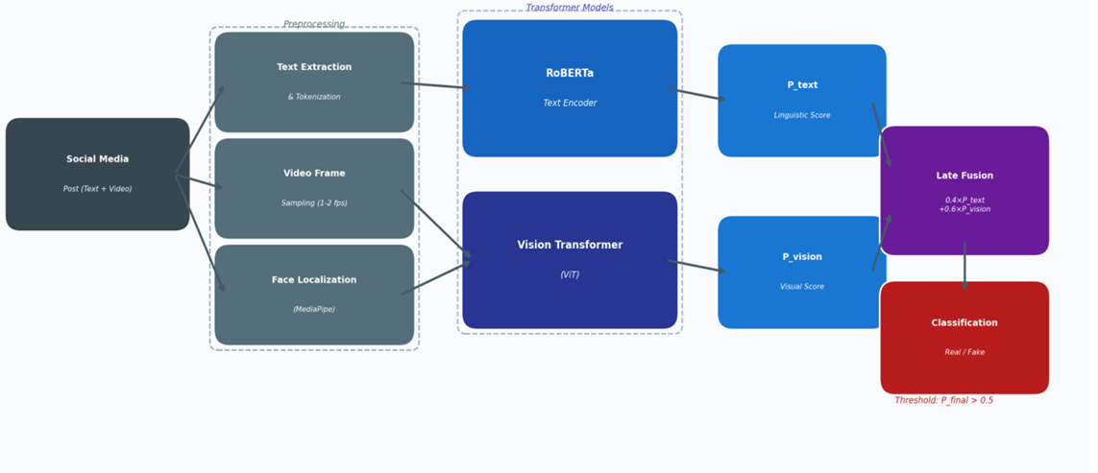
Proposed Architecture

Slide 9
Two Expert Transformer Models
RoBERTa — Linguistic Analysis
ViT — Visual Forensics
12 encoder layers, 125M parameters. Detects sensationalist tone, absent attributions, emotional amplification, and logical inconsistencies. Outputs P_text via sigmoid classification head on [CLS] token.
12-layer Vision Transformer processing 196 patches per frame. Detects boundary discontinuities, illumination anomalies, GAN spectral artefacts, and texture inconsistencies. Outputs P_vision via temporal mean pooling across frames.

Slide 10
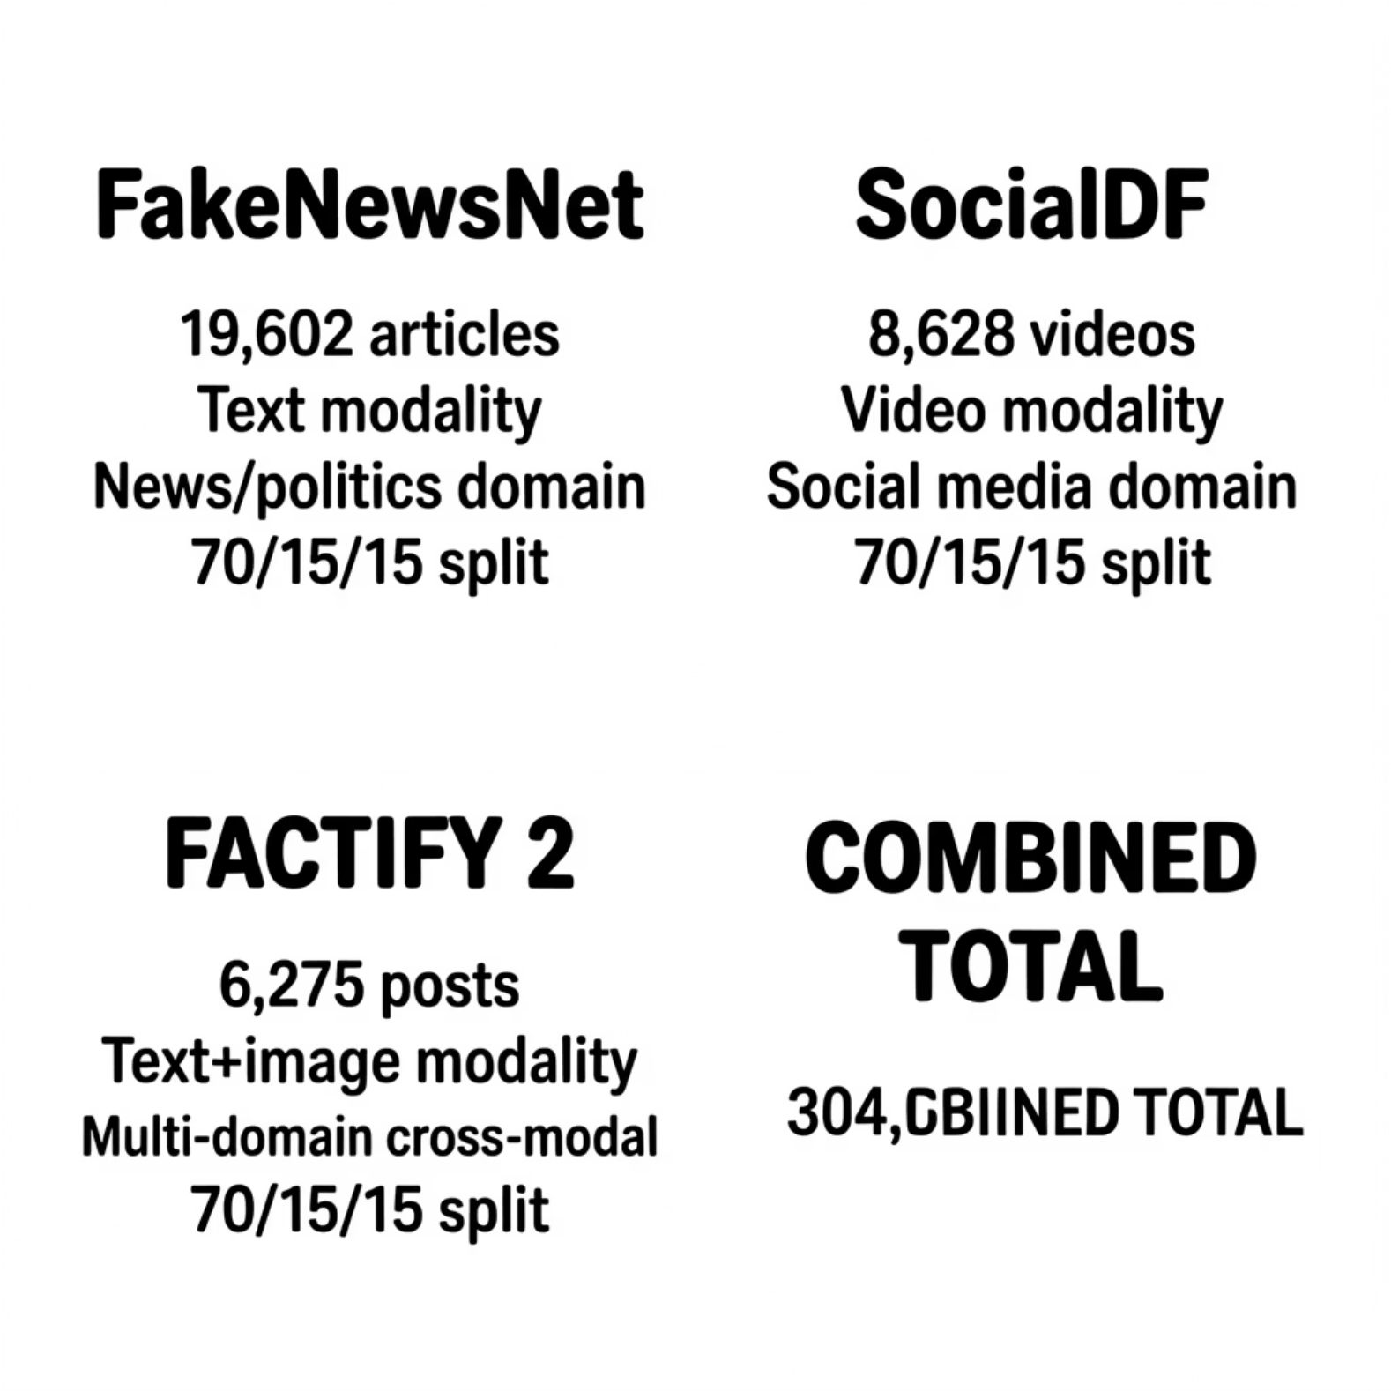

Three Complementary Benchmarks
The framework is evaluated across 34,505 samples spanning textual misinformation, deepfake video, and cross-modal entailment — ensuring robust generalisation across the full spectrum of multimodal fake news.

Slide 11
Late Fusion Strategy
Weighted Decision Rule
Independent models develop complementary error patterns, reducing aggregate variance
Fusion weight \alpha = 0.4 determined via grid search on held-out validation data. Higher visual weight reflects stronger, more objective forensic evidence from deepfake artefacts.
Each branch can be retrained or replaced without modifying the pipeline
Graceful degradation when one modality is absent or corrupted
Classification threshold = 0.50 optimised for balanced precision-recall; adjustable for deployment-specific cost asymmetries.
Modality contributions are explicitly quantified by fusion weights

Slide 12
Implementation & Training
Hyperparameter
RoBERTa (Text)
ViT (Visual)
Pretrained Checkpoint
roberta-base
vit-base-patch16-224
Batch Size
32
16
Learning Rate
2×10⁻⁵
1×10⁻⁵
Optimizer
AdamW
AdamW
Epochs
30 (early stopping)
30 (early stopping)
GPU
NVIDIA A100 40GB
NVIDIA A100 40GB
Training Time
~4.2 hours
~6.8 hours
Face detection via MediaPipe BlazeFace achieves 98.3% detection rate. Full pipeline inference throughput: ~14 posts/second on a single GPU — meeting real-time social media moderation requirements.

Slide 13
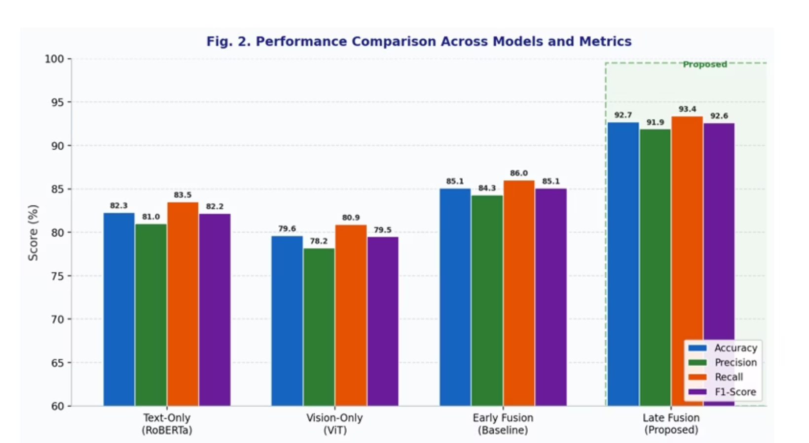
Experimental Results
Key Findings (n = 3,800 test samples)
F1-Score: 92.6%
AUC: 0.967
+10.4 pp vs. text-only, +13.1 pp vs. vision-only, +7.5 pp vs. early fusion
Correctly ranks misinformation above credible posts 96.7% of the time
Accuracy: 92.7%
True positive rates: 95.0% (real), 96.2% (fake)

Slide 14
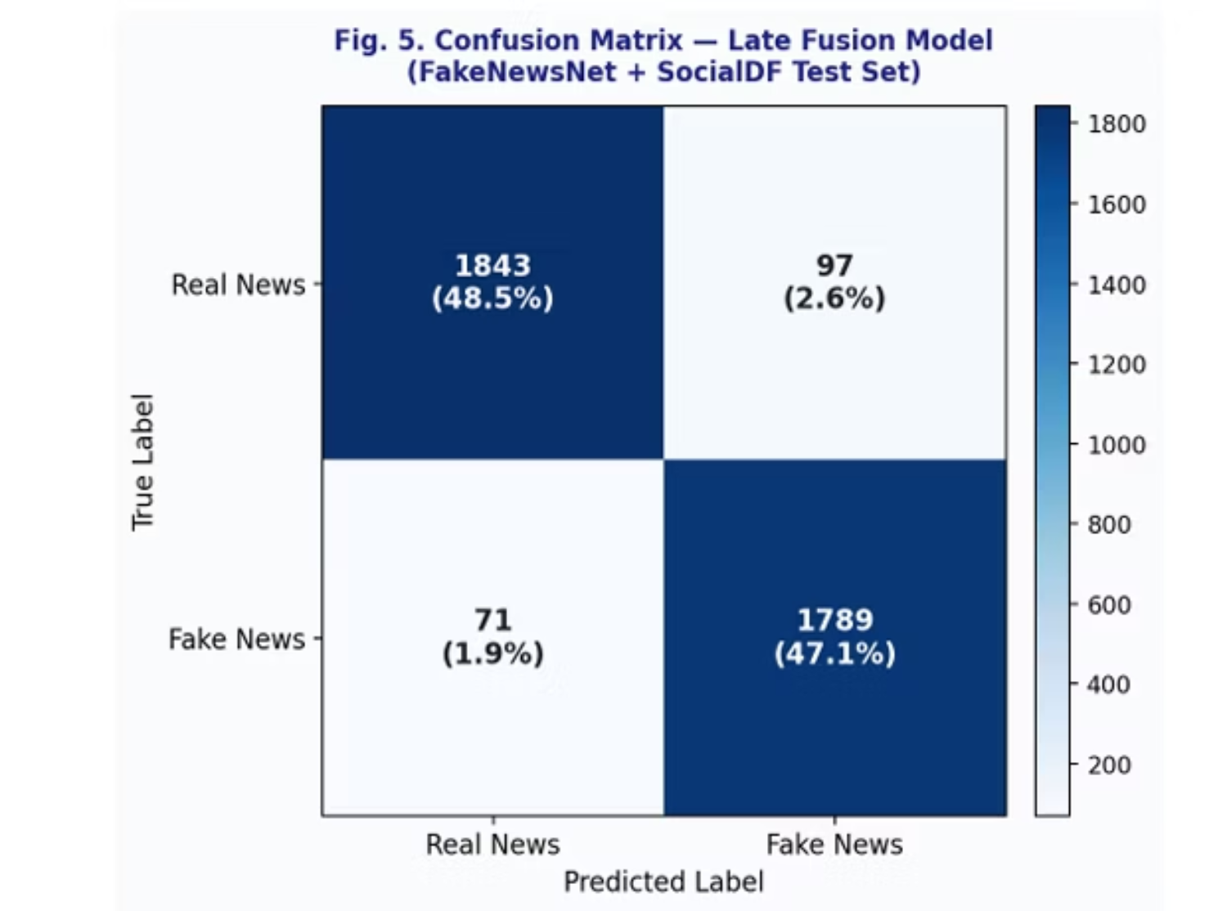
Per-Dataset Performance & Limitations
Identified Limitations
Non-Facial Imagery
Doctored charts, event photos, and geographical images fall back to text-only accuracy
LLM-Generated Text
High-quality LLM misinformation may be stylistically indistinguishable from credible journalism
Domain Generalisation
Fusion weights calibrated on benchmark distributions may not generalise to out-of-distribution domains

Slide 15
CONCLUSION
Successfully built a multimodal fake news detection system that analyzes both textual and visual content of social media posts simultaneously.
Proved that treating text and image/video as independent expert branches and combining them at decision level gives better results than merging them early.
The system is not just academically sound but also practically usable — works in real-time, handles missing data, and can be updated modularly.
This work bridges the gap between NLP and Computer Vision to tackle one of the most pressing challenges of the digital age — misinformation.

Slide 16
FUTURE WORK
In future, the visual branch can be extended to detect non-facial image manipulation such as doctored charts and fake event photos using Error Level Analysis.
The static fusion weights can be replaced with a dynamic meta-learner that adjusts text and vision contributions based on each input.
Social context signals like propagation graphs and account credibility can be added as a third modality to further improve detection.
Continual learning strategies can also be applied so the model automatically adapts to new and evolving deepfake techniques without requiring full retraining.

Slide 17
QUESTIONS
Why Late Fusion over Early Fusion?
Why assign higher weight to vision (0.6) than text (0.4)?
How does the system handle posts with no face detected?
Why RoBERTa over BERT?
Why Vision Transformer over CNN for deepfake detection?
What happens when both modalities give conflicting predictions?
How did you choose the decision threshold of 0.5?
Can this system work in real-time on a normal laptop without GPU?

Slide 18
Thank You

